Slide 1

Apache Mesos Design Decisions
mesos.apache.org
@ApacheMesos
Benjamin Hindman – @benh

Slide 2

this is not a talk about YARN

Slide 3
at least not explicitly!

Slide 4
this talk is about Mesos!

Slide 5
a little history
Mesos started as a research project at Berkeley in early 2009 by Benjamin Hindman, Andy Konwinski, Matei Zaharia, Ali Ghodsi, Anthony D. Joseph, Randy Katz, Scott Shenker, Ion Stoica

Slide 6

our motivation
increase performance and utilization of clusters

Slide 7
our intuition
static partitioning considered harmful

Slide 8

static partitioning considered harmful
datacenter

Slide 9



static partitioning considered harmful

Slide 10
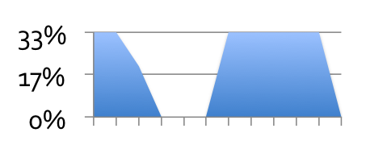
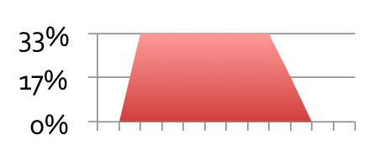
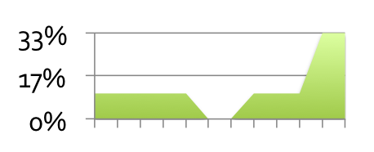
static partitioning considered harmful

Slide 11
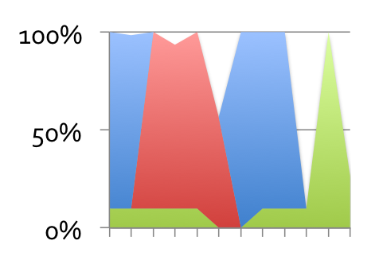
static partitioning considered harmful

Slide 12
static partitioning considered harmful
faster!

Slide 13
static partitioning considered harmful
higher utilization!

Slide 14
our intuition
build new frameworks

Slide 15
“Map/Reduce is a big hammer, but not everything is a nail!”

Slide 16
Apache Mesos is a distributed system for running and building other distributed systems

Slide 17
Mesos is a cluster manager

Slide 18
Mesos is a resource manager

Slide 19
Mesos is a resource negotiator

Slide 20
Mesos replaces static partitioning of resources to frameworks with dynamic resource allocation

Slide 21

Mesos is a distributed system with a master/slave architecture
masters
slaves

Slide 22

frameworks register with the Mesos master in order to run jobs/tasks
frameworks
masters
slaves

Slide 23
frameworks can be required to authenticate as a principal
framework
SASL
CRAM-MD5 secret mechanism
(Kerberos in development)
SASL
masters
masters initialized with secrets

Slide 24
Mesos @Twitter in early 2010 goal: run long-running services elastically on Mesos

Slide 25






Apache Aurora (incubating)
Aurora is a Mesos framework that makes it easy to launch services written in Ruby, Java, Scala, Python, Go, etc!
masters

Slide 26

Storm, Jenkins, …
masters

Slide 27
a lot of interesting design decisions along the way

Slide 28
many appear (IMHO) in YARN too

Slide 29
design decisions
two-level scheduling and resource offers
fair-sharing and revocable resources
high-availability and fault-tolerance
execution and isolation
C++

Slide 30
design decisions
two-level scheduling and resource offers
fair-sharing and revocable resources
high-availability and fault-tolerance
execution and isolation
C++

Slide 31
frameworks get allocated resources from the masters
framework
resources are allocated via
resource offers
a resource offer represents a snapshot of available resources (one offer per host) that a framework can use to run tasks
offer
hostname
4 CPUs
4 GB RAM
masters

Slide 32
frameworks use these resources to decide what tasks to run
framework
task
3 CPUs
2 GB RAM
a task can use a subset of an offer
masters

Slide 33
Mesos challenged the status quo of cluster managers

Slide 34
cluster manager status quo
application
the specification includes as much information as possible to assist the cluster manager in scheduling and execution
specification
cluster manager

Slide 35
cluster manager status quo
wait for task to be executed
application
cluster manager

Slide 36
cluster manager status quo
application
result
cluster manager

Slide 37
problems with specifications
hard to specify certain desires or constraints
hard to update specifications dynamically as tasks executed and finished/failed

Slide 38
an alternative model
framework
request
3 CPUs
2 GB RAM
a request is purposely simplified subset of a specification, mainly including the required resources
masters

Slide 39
question: what should Mesos do if it can’t satisfy a request?

Slide 40
question: what should Mesos do if it can’t satisfy a request?
wait until it can …

Slide 41
question: what should Mesos do if it can’t satisfy a request?
wait until it can …
offer the best it can immediately

Slide 42
question: what should Mesos do if it can’t satisfy a request?
wait until it can …
offer the best it can immediately

Slide 43
an alternative model
framework
offer
hostname
4 CPUs
4 GB RAM
masters

Slide 44
an alternative model
framework
offer
hostname
4 CPUs
4 GB RAM
offer
hostname
4 CPUs
4 GB RAM
offer
hostname
4 CPUs
4 GB RAM
offer
hostname
4 CPUs
4 GB RAM
masters

Slide 45
an alternative model
framework
offer
hostname
4 CPUs
4 GB RAM
offer
hostname
4 CPUs
4 GB RAM
offer
hostname
4 CPUs
4 GB RAM
offer
hostname
4 CPUs
4 GB RAM
framework uses the offers to perform it’s own scheduling
masters

Slide 46
an analogue: non-blocking sockets
application
write(s, buffer, size);
kernel

Slide 47
an analogue: non-blocking sockets
application
42 of 100 bytes written!
kernel

Slide 48
resource offers address asynchrony in resource allocation

Slide 49
IIUC, even YARN allocates “the best it can” to an application when it can’t satisfy a request

Slide 50
requests are complimentary (but not necessary)

Slide 51
offers represent the currently available resources a framework can use

Slide 52
question: should resources within offers be disjoint?

Slide 53
framework1
framework2
offer
hostname
4 CPUs
4 GB RAM
offer
hostname
4 CPUs
4 GB RAM
masters

Slide 54
concurrency control
pessimistic
optimistic

Slide 55
concurrency control
pessimistic
optimistic
all offers overlap with one another, thus causing frameworks to “compete” first-come-first-served

Slide 56
concurrency control
pessimistic
optimistic
offers made to different frameworks are disjoint

Slide 57
Mesos semantics: assume overlapping offers

Slide 58
design comparison: Google’s Omega

Slide 59
the Omega model
framework
snapshot
a framework gets a snapshot of the cluster state from a database (note, does not make a request!)
database

Slide 60
the Omega model
framework
a framework submits a transaction to the database to “acquire” resources (which it can then use to run tasks)
failed transactions occur when another framework has already acquired sought resources
transaction
database

Slide 61
isomorphism?

Slide 62
observation: snapshots are optimistic offers

Slide 63
Omega and Mesos
framework
framework
offer
hostname
4 CPUs
4 GB RAM
snapshot
database
masters

Slide 64
Omega and Mesos
framework
framework
transaction
task
3 CPUs
2 GB RAM
database
masters

Slide 65
thought experiment: what’s gained by exploiting the continuous spectrum of pessimistic to optimistic?
pessimistic
optimistic

Slide 66
design decisions
two-level scheduling and resource offers
fair-sharing and revocable resources
high-availability and fault-tolerance
execution and isolation
C++

Slide 67
Mesos allocates resources to frameworks using a fair-sharing algorithm we created called Dominant Resource Fairness (DRF)

Slide 68
DRF, born of static partitioning
datacenter

Slide 69
static partitioning across teams
team
promotions
trends
recommendations

Slide 70
static partitioning across teams
team
promotions
trends
recommendations
fairly shared!

Slide 71
goal: fairly share the resources without static partitioning

Slide 72
partition utilizations
team
promotions
trends
recommendations
45% CPU
100% RAM
75% CPU
100% RAM
100% CPU
50% RAM
utilization

Slide 73
observation: a dominant resource bottlenecks each team from running any more jobs/tasks

Slide 74
dominant resource bottlenecks
team
promotions
trends
recommendations
45% CPU
100% RAM
75% CPU
100% RAM
100% CPU
50% RAM
utilization
bottleneck
RAM
RAM
CPU

Slide 75
insight: allocating a fair share of each team’s dominant resource guarantees they can run at least as many jobs/tasks as with static partitioning!

Slide 76
… if my team gets at least 1/N of my dominant resource I will do no worse than if I had my own cluster, but I might do better when resources are available!

Slide 77
DRF in Mesos
framework
frameworks specify a role when they register (i.e., the team to charge for the resources)
masters

Slide 78
DRF in Mesos
framework
frameworks specify a role when they register (i.e., the team to charge for the resources)
master calculates each role’s dominant resource (dynamically) and allocates appropriately
masters

Slide 79
tep 4: Profit (statistical multiplexing)
$

Slide 80
in practice, fair sharing is insufficient

Slide 81
weighted fair sharing
team
promotions
trends
recommendations

Slide 82
weighted fair sharing
team
promotions
trends
recommendations
weight
0.17
0.5
0.33

Slide 83
Mesos implements weighted DRF
masters can be configured with weights per role
resource allocation decisions incorporate the weights to determine dominant fair shares
masters

Slide 84
in practice, weighted fair sharing is still insufficient

Slide 85
a non-cooperative framework (i.e., has long tasks or is buggy) can get allocated too many resources

Slide 86
Mesos provides reservations
framework (trends)
slaves can be configured with resource reservations for particular roles (dynamic, time based, and percentage based reservations are in development)
resource offers include the reservation role (if any)
offer
hostname
4 CPUs
4 GB RAM
role: trends
masters

Slide 87
reservations provide guarantees, but at the cost of utilization
reservations

Slide 88
revocable resources
framework (promotions)
reserved resources that are unused can be allocated to frameworks from different roles but those resources may be revoked at any time
offer
hostname
4 CPUs
4 GB RAM
role: trends
masters

Slide 89
preemption via revocation
… my tasks will not be killed unless I’m using revocable resources!

Slide 90
design decisions
two-level scheduling and resource offers
fair-sharing and revocable resources
high-availability and fault-tolerance
execution and isolation
C++

Slide 91
high-availability and fault-tolerance a prerequisite @twitter
machine failure
process failure (bugs!)
upgrades
framework failover
master failover
slave failover

Slide 92
high-availability and fault-tolerance a prerequisite @twitter
machine failure
process failure (bugs!)
upgrades
framework failover
master failover
slave failover

Slide 93
framework failover
framework
framework
framework re-registers with master and resumes operation
all tasks keep running across framework failover!
masters

Slide 94
high-availability and fault-tolerance a prerequisite @twitter
machine failure
process failure (bugs!)
upgrades
framework failover
master failover
slave failover

Slide 95
master failover
framework
after a new master is elected all frameworks and slaves connect to the new master
all tasks keep running across master failover!
masters

Slide 96
high-availability and fault-tolerance a prerequisite @twitter
machine failure
process failure (bugs!)
upgrades
framework failover
master failover
slave failover

Slide 97
slave failover
mesos-slave
task
task
slave

Slide 98
slave failover
mesos-slave
task
task
slave

Slide 99
slave failover
task
task
slave

Slide 100
slave failover
mesos-slave
task
task
slave

Slide 101
slave failover
mesos-slave
task
task
slave

Slide 102

slave failover @twitter
mesos-slave
slave
(large in-memory services,
expensive to restart)

Slide 103
design decisions
two-level scheduling and resource offers
fair-sharing and revocable resources
high-availability and fault-tolerance
execution and isolation
C++

Slide 104
execution
framework
frameworks launch fine-grained tasks for execution
if necessary, a framework can provide an executor to handle the execution of a task
task
3 CPUs
2 GB RAM
masters

Slide 105
executor
mesos-slave
executor
task
slave
task

Slide 106
executor
mesos-slave
executor
task
slave
task
task

Slide 107
executor
mesos-slave
executor
task
slave

Slide 108
goal: isolation

Slide 109
isolation
mesos-slave
executor
task
slave
task

Slide 110
isolation
mesos-slave
executor
task
slave
containers
task

Slide 111
executor + task design means containers can have changing resource allocations

Slide 112
isolation
mesos-slave
executor
task
slave
task

Slide 113
isolation
mesos-slave
executor
task
slave
task

Slide 114
isolation
mesos-slave
executor
task
slave
task

Slide 115
isolation
mesos-slave
executor
task
slave
task

Slide 116
isolation
mesos-slave
executor
task
slave
task

Slide 117
isolation
mesos-slave
executor
task
slave
task

Slide 118
isolation
mesos-slave
executor
task
slave
task

Slide 119
making the task first-class gives us true fine-grained resources sharing

Slide 120
requirement: fast task launching (i.e., milliseconds or less)

Slide 121
virtual machines an anti-pattern

Slide 122


operating-system virtualization
containers
(zones and projects)
control groups (cgroups)
namespaces

Slide 123
isolation support
tight integration with cgroups
CPU (upper and lower bounds)
memory
network I/O (traffic controller, in development)
filesystem (using LVM, in development)

Slide 124
statistics too
rarely does allocation == usage (humans are bad at estimating the amount of resources they’re using)
used @twitter for capacity planning (and oversubscription in development)

Slide 125
CPU upper bounds? in practice, determinism trumps utilization

Slide 126
design decisions
two-level scheduling and resource offers
fair-sharing and revocable resources
high-availability and fault-tolerance
execution and isolation
C++

Slide 127
requirements:
performance
maintainability (static typing)
interfaces to low-level OS (for isolation, etc)
interoperability with other languages (for library bindings)

Slide 128
garbage collection a performance anti-pattern

Slide 129
consequences:
antiquated libraries (especially around concurrency and networking)
nascent community

Slide 130
github.com/3rdparty/libprocess concurrency via futures/actors, networking via message passing

Slide 131
github.com/3rdparty/stout monads in C++, safe and understandable utilities

Slide 132
but …

Slide 133
scalability simulations to 50,000+ slaves

Slide 134
@twitter we run multiple Mesos clusters each with 3500+ nodes

Slide 135
design decisions
two-level scheduling and resource offers
fair-sharing and revocable resources
high-availability and fault-tolerance
execution and isolation
C++

Slide 136
final remarks

Slide 137
frameworks
Hadoop (github.com/mesos/hadoop)
Spark (github.com/mesos/spark)
DPark (github.com/douban/dpark)
Storm (github.com/nathanmarz/storm)
Chronos (github.com/airbnb/chronos)
MPICH2 (in mesos git repository)
Marathon (github.com/mesosphere/marathon)
Aurora (github.com/twitter/aurora)

Slide 138
write your next distributed system with Mesos!

Slide 139
port a framework to Mesos
write a “wrapper”
~100 lines of code to write a wrapper (the more lines, the more you can take advantage of elasticity or other mesos features)
see http://github.com/mesos/hadoop

Slide 140
Thank You!
mesos.apache.org
mesos.apache.org/blog
@ApacheMesos

Slide 143
master failover
framework
after a new master is elected all frameworks and slaves connect to the new master
all tasks keep running across master failover!
master

Slide 144
stateless master
to make master failover fast, we choose to make the master stateless
state is stored in the leaves, at the frameworks and the slaves
makes sense for frameworks that don’t want to store state (i.e., can’t actually failover)
consequences: slaves are fairly complicated (need to checkpoint), frameworks need to save their own state and reconcile (we built some tools to help, including a replicated log)

Slide 145
master failover
to make master failover fast, we choose to make the master stateless
state is stored in the leaves, at the frameworks and the slaves
makes sense for frameworks that don’t want to store state (i.e., can’t actually failover)
consequences: slaves are fairly complicated (need to checkpoint), frameworks need to save their own state and reconcile (we built some tools to help, including a replicated log)

Slide 148
Apache Mesos is a distributed system for running and building other distributed systems

Slide 149
origins
Berkeley research project including Benjamin Hindman, Andy Konwinski, Matei Zaharia, Ali Ghodsi, Anthony D. Joseph, Randy Katz, Scott Shenker, Ion Stoica
mesos.apache.org/documentation

Slide 150
ecosystem
operators
framework
developers
mesos
developers

Slide 151
a tour of mesos from different perspectives of the ecosystem

Slide 152
the operator

Slide 153
the operator
People who run and manage frameworks (Hadoop, Storm, MPI, Spark, Memcache, etc)
Tools: virtual machines, Chef, Puppet (emerging: PAAS, Docker)
“ops” at most companies (SREs at Twitter)
the static partitioners

Slide 154
for the operator, Mesos is a cluster manager

Slide 155
for the operator, Mesos is a resource manager

Slide 156
for the operator, Mesos is a resource negotiator

Slide 157
for the operator, Mesos replaces static partitioning of resources to frameworks with dynamic resource allocation

Slide 158
for the operator, Mesos is a distributed system with a master/slave architecture
masters
slaves

Slide 159
frameworks/applications register with the Mesos master in order to run jobs/tasks
masters
slaves

Slide 160
frameworks can be required to authenticate as a principal*
framework
SASL
CRAM-MD5 secret mechanism
(Kerberos in development)
SASL
masters
masters initialized with secrets

Slide 161
Mesos is highly-available and fault-tolerant

Slide 162
the framework developer

Slide 163
the framework developer
…

Slide 164
Mesos uses Apache ZooKeeper for coordination
Apache
ZooKeeper
masters
slaves

Slide 165
increase utilization with revocable resources and preemption
framework1
framework2
framework3
hostname:
4 CPUs
4 GB RAM
role: -
masters

Slide 166
optimistic vs pessimistic
what to say here …

Slide 167
authorization*
principals can be used for:
authorizing allocation roles
authorizing operating system users (for execution)

Slide 168
authorization

Slide 169
agenda
motivation and overview
resource allocation
frameworks, schedulers, tasks, status updates
high-availability
resource isolation and statistics
security
case studies

Slide 170
agenda
motivation and overview
resource allocation
frameworks, schedulers, tasks, status updates
high-availability
resource isolation and statistics
security
case studies

Slide 171
I’d love to answer some questions with the help of my data!

Slide 172
I think I’ll try Hadoop.

Slide 173

your datacenter

Slide 174
+ Hadoop

Slide 175
happy?

Slide 176

Not exactly …

Slide 177
… Hadoop is a big hammer, but not everything is a nail!

Slide 178

I’ve got some iterative algorithms, I want to try Spark!

Slide 179
datacenter management

Slide 180
datacenter management

Slide 181
datacenter management

Slide 182
static partitioning

Slide 183
static partitioning

Slide 184
static partitioning considered harmful

Slide 185
static partitioning considered harmful
hard to share data
hard to scale elastically (to exploit statistical multiplexing)
hard to fully utilize machines
hard to deal with failures

Slide 186
static partitioning considered harmful
hard to share data
hard to scale elastically (to exploit statistical multiplexing)
hard to fully utilize machines
hard to deal with failures

Slide 187

Hadoop …
(map/reduce)
(distributed file system)

Slide 188
HDFS

Slide 189
HDFS

Slide 190
HDFS

Slide 191
Could we just give Spark it’s own HDFS cluster too?

Slide 192
HDFS x 2

Slide 193
HDFS x 2

Slide 194
HDFS x 2

Slide 195
HDFS x 2
tee incoming data
(2 copies)

Slide 196
HDFS x 2
tee incoming data
(2 copies)
periodic copy/sync

Slide 197

That sounds annoying … let’s not do that. Can we do any better though?

Slide 198
HDFS

Slide 199
HDFS

Slide 200
HDFS

Slide 201
HDFS

Slide 202
static partitioning considered harmful
hard to share data
hard to scale elastically (to exploit statistical multiplexing)
hard to fully utilize machines
hard to deal with failures

Slide 203
During the day I’d rather give more machines to Spark but at night I’d rather give more machines to Hadoop!

Slide 204
datacenter management

Slide 205
datacenter management

Slide 206
datacenter management

Slide 207
datacenter management

Slide 209
static partitioning considered harmful
hard to share data
hard to scale elastically (to exploit statistical multiplexing)
hard to fully utilize machines
hard to deal with failures

Slide 210
datacenter management

Slide 211
datacenter management

Slide 212
datacenter management

Slide 213
static partitioning considered harmful
hard to share data
hard to scale elastically (to exploit statistical multiplexing)
hard to fully utilize machines
hard to deal with failures

Slide 214
datacenter management

Slide 215
datacenter management

Slide 216
datacenter management

Slide 220


Slide 221
I don’t want to deal with this!

Slide 222
the datacenter …
rather than think about the datacenter like this …

Slide 223
… is a computer
think about it like this …

Slide 224
datacenter computer
applications
resources
filesystem

Slide 225
mesos
applications
kernel
resources
filesystem

Slide 226
mesos
applications
kernel
resources
filesystem

Slide 227
mesos
frameworks
kernel
resources
filesystem

Slide 228
Step 1: filesystem

Slide 229
Step 2: mesos
run a “master” (or multiple for high availability)

Slide 230

Step 2: mesos
run “slaves” on the rest of the machines

Slide 231
Step 3: frameworks

Slide 232
Step 3: frameworks

Slide 233
Step 3: frameworks

Slide 234
Step 3: frameworks

Slide 235
Step 3: frameworks

Slide 236
Step 3: frameworks

Slide 237
Step 3: frameworks

Slide 238
Step 3: frameworks

Slide 239
Step 3: frameworks

Slide 240
Step 3: frameworks

Slide 241
Step 3: frameworks

Slide 242
Step 3: frameworks

Slide 243
Step 3: frameworks

Slide 244
tep 4: profit
$

Slide 245
tep 4: profit (statistical multiplexing)
$

Slide 246
tep 4: profit (statistical multiplexing)
$

Slide 247
tep 4: profit (statistical multiplexing)
$

Slide 248
tep 4: profit (statistical multiplexing)
$

Slide 249
tep 4: profit (statistical multiplexing)
$

Slide 250
tep 4: profit (statistical multiplexing)
$
reduces CapEx and OpEx!

Slide 251
tep 4: profit (statistical multiplexing)
$
reduces latency!

Slide 252
tep 4: profit (utilize)
$

Slide 253
tep 4: profit (utilize)
$

Slide 254
tep 4: profit (utilize)
$

Slide 255
tep 4: profit (utilize)
$

Slide 256
tep 4: profit (utilize)
$

Slide 257
tep 4: profit (utilize)
$

Slide 258
tep 4: profit (failures)
$

Slide 259
tep 4: profit (failures)
$

Slide 260
tep 4: profit (failures)
$

Slide 261
agenda
motivation and overview
resource allocation
frameworks, schedulers, tasks, status updates
high-availability
resource isolation and statistics
security
case studies

Slide 262
agenda
motivation and overview
resource allocation
frameworks, schedulers, tasks, status updates
high-availability
resource isolation and statistics
security
case studies

Slide 263
mesos
frameworks
kernel
resources
filesystem

Slide 264
mesos
frameworks
kernel
resources

Slide 265
resource allocation

Slide 266
resource allocation

Slide 267
reservations
can reserve resources per slave to provide guaranteed resources
requires human participation (ops) to determine what roles should be reserved what resources
kind of like thread affinity, but across many machines (and not just for CPUs)

Slide 268
resource allocation

Slide 269
resource allocation

Slide 270
resource allocation
allocate reserved resources to frameworks authorized for a particular role
allocate unused reserved resources and unused unreserved resources fairly amongst all frameworks according to their weights

Slide 271
preemption
if a framework runs tasks outside of it’s reservations they can be preempted (i.e., the task killed and the resources revoked) for a framework running a task within its reservation

Slide 272
agenda
motivation and overview
resource allocation
frameworks, schedulers, tasks, status updates
high-availability
resource isolation and statistics
security
case studies

Slide 273
mesos
frameworks
kernel

Slide 274
framework ≈ distributed system

Slide 275
framework commonality
run processes/tasks simultaneously (distributed)
handle process failures (fault-tolerant)
optimize performance (elastic)

Slide 276
framework commonality
run processes/tasks simultaneously (distributed)
handle process failures (fault-tolerant)
optimize performance (elastic)
coordinate execution

Slide 277
frameworks are execution coordinators

Slide 278
frameworks are execution coordinators

Slide 279
frameworks are execution schedulers

Slide 280
end-to-end principle
“application-specific functions ought to reside in the end hosts of a network rather than intermediary nodes”
i.e., frameworks want to coordinate their tasks execution and they should be able to

Slide 281
framework anatomy
frameworks

Slide 282
framework anatomy
frameworks
scheduling API

Slide 283
scheduling

Slide 284
scheduling
i’d like to run some tasks!

Slide 285
scheduling
here are some resource offers!

Slide 286
resource offers
an offer represents the snapshot of available resources on a particular machine that a framework can use to run tasks
schedulers pick which resources to use to run their tasks
foo.bar.com:
4 CPUs
4 GB RAM

Slide 287
“two-level scheduling”
mesos: controls resource allocations to schedulers
schedulers: make decisions about what to run given allocated resources

Slide 288
concurrency control
the same resources may be offered to different frameworks

Slide 289
concurrency control
the same resources may be offered to different frameworks
pessimistic
optimistic
no overlapping offers
all overlapping offers

Slide 290
tasks
the “threads” of the framework, a consumer of resources (cpu, memory, etc)
either a concrete command line or an opaque description (which requires an executor)

Slide 291
tasks
here are some resources!

Slide 292
tasks
launch these tasks!

Slide 293
tasks

Slide 294
tasks

Slide 295
status updates

Slide 296
status updates

Slide 297
status updates
task status update!

Slide 298
status updates

Slide 299
status updates

Slide 300
status updates
task status update!

Slide 301
more scheduling

Slide 302
more scheduling
i’d like to run some tasks!

Slide 303
agenda
motivation and overview
resource allocation
frameworks, schedulers, tasks, status updates
high-availability
resource isolation and statistics
security
case studies

Slide 304
high-availability

Slide 305
high-availability (master)

Slide 306
high-availability (master)

Slide 307
high-availability (master)

Slide 308
high-availability (master)

Slide 309
high-availability (master)

Slide 310
high-availability (master)
task status update!

Slide 311
high-availability (master)
i’d like to run some tasks!

Slide 312
high-availability (master)

Slide 313
high-availability (framework)

Slide 314
high-availability (framework)

Slide 315
high-availability (framework)

Slide 316
high-availability (framework)

Slide 317
high-availability (slave)

Slide 318
high-availability (slave)

Slide 319
high-availability (slave)

Slide 320
agenda
motivation and overview
resource allocation
frameworks, schedulers, tasks, status updates
high-availability
resource isolation and statistics
security
case studies

Slide 321
resource isolation
leverage Linux control groups (cgroups)
CPU (upper and lower bounds)
memory
network I/O (traffic controller, in progress)
filesystem (lvm, in progress)

Slide 322
resource statistics
rarely does allocation == usage (humans are bad at estimating the amount of resources they’re using)
per task/executor statistics are collected (for all fork/exec’ed processes too!)
can help with capacity planning

Slide 323
agenda
motivation and overview
resource allocation
frameworks, schedulers, tasks, status updates
high-availability
resource isolation and statistics
security
case studies

Slide 324
security
Twitter recently added SASL support, default mechanism is CRAM-MD5, will support Kerberos in the short term

Slide 325
agenda
motivation and overview
resource allocation
frameworks, schedulers, tasks, status updates
high-availability
resource isolation and statistics
security
case studies

Slide 326
framework commonality
run processes/tasks simultaneously (distributed)
handle process failures (fault-tolerant)
optimize performance (elastic)

Slide 327
framework commonality
as a “kernel”, mesos provides a lot of primitives that make writing a new framework easier such as launching tasks, doing failure detection, etc, why re-implement them each time!?

Slide 328
case study: chronos
distributed cron with dependencies
developed at airbnb
~3k lines of Scala!
distributed, highly available, and fault tolerant without any network programming!
http://github.com/airbnb/chronos

Slide 329
analytics

Slide 330
analytics + services

Slide 331
analytics + services

Slide 332
analytics + services

Slide 333
case study: aurora
“run 200 of these, somewhere, forever”
developed at Twitter
highly available (uses the mesos replicated log)
uses a python DSL to describe services
leverages service discovery and proxying (see Twitter commons)
http://github.com/twitter/aurora

Slide 334
frameworks
Hadoop (github.com/mesos/hadoop)
Spark (github.com/mesos/spark)
DPark (github.com/douban/dpark)
Storm (github.com/nathanmarz/storm)
Chronos (github.com/airbnb/chronos)
MPICH2 (in mesos git repository)
Marathon (github.com/mesosphere/marathon)
Aurora (github.com/twitter/aurora)

Slide 335
write your next distributed system with mesos!

Slide 336
port a framework to mesos
write a “wrapper” scheduler
~100 lines of code to write a wrapper (the more lines, the more you can take advantage of elasticity or other mesos features)
see http://github.com/mesos/hadoop

Slide 337
conclusions
datacenter management is a pain

Slide 338
conclusions
mesos makes running frameworks on your datacenter easier as well as increasing utilization and performance while reducing CapEx and OpEx!

Slide 339
conclusions
rather than build your next distributed system from scratch, consider using mesos

Slide 340
conclusions
you can share your datacenter between analytics and online services!

Slide 341
Questions?
mesos.apache.org
@ApacheMesos

Slide 342
aurora

Slide 343

aurora

Slide 344
aurora

Slide 345
aurora

Slide 346
aurora

Slide 347
framework commonality
run processes simultaneously (distributed)
handle process failures (fault-tolerance)
optimize execution (elasticity, scheduling)

Slide 348
primitives
scheduler – distributed system “master” or “coordinator”
(executor – lower-level control of task execution, optional)
requests/offers – resource allocations
tasks – “threads” of the distributed system
…

Slide 349

scheduler
Apache
Hadoop
Chronos

Slide 350
scheduler
(1) brokers for resources
(2) launches tasks
(3) handles task termination

Slide 351
brokering for resources
(1) make resource requests
2 CPUs
1 GB RAM
slave *
(2) respond to resource offers
4 CPUs
4 GB RAM
slave foo.bar.com

Slide 352
offers: non-blocking resource allocation
exist to answer the question:
“what should mesos do if it can’t satisfy a request?”
(1) wait until it can
(2) offer the best allocation it can immediately

Slide 353
offers: non-blocking resource allocation
exist to answer the question:
“what should mesos do if it can’t satisfy a request?”
(1) wait until it can
(2) offer the best allocation it can immediately

Slide 354
resource allocation
request
Apache
Hadoop
Chronos

Slide 355
resource allocation
request
Apache
Hadoop
Chronos
allocator
dominant resource fairness
resource reservations

Slide 356
resource allocation
request
Apache
Hadoop
Chronos
allocator
dominant resource fairness
resource reservations
pessimistic
optimistic

Slide 357
resource allocation
request
Apache
Hadoop
Chronos
allocator
dominant resource fairness
resource reservations
pessimistic
optimistic
no overlapping offers
all overlapping offers

Slide 358
resource allocation
offer
Apache
Hadoop
Chronos
allocator
dominant resource fairness
resource reservations

Slide 359
“two-level scheduling”
mesos: controls resource allocations to framework schedulers
schedulers: make decisions about what to run given allocated resources

Slide 360
end-to-end principle
“application-specific functions ought to reside in the end hosts of a network rather than intermediary nodes”

Slide 361
tasks
either a concrete command line or an opaque description (which requires a framework executor to execute)
a consumer of resources

Slide 362
task operations
launching/killing
health monitoring/reporting (failure detection)
resource usage monitoring (statistics)

Slide 363
resource isolation
cgroup per executor or task (if no executor)
resource controls adjusted dynamically as tasks come and go!

Slide 364
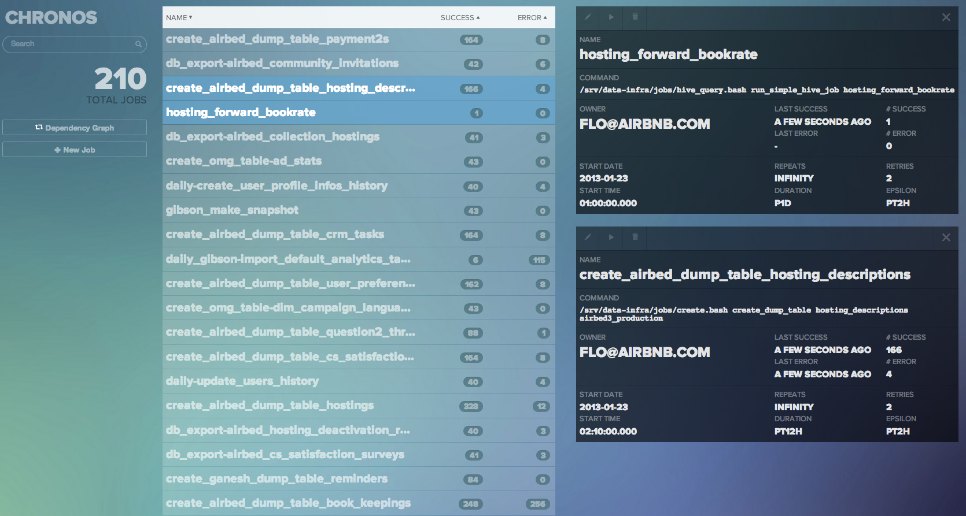
case study: chronos
distributed cron with dependencies
built at airbnb by @flo

Slide 365
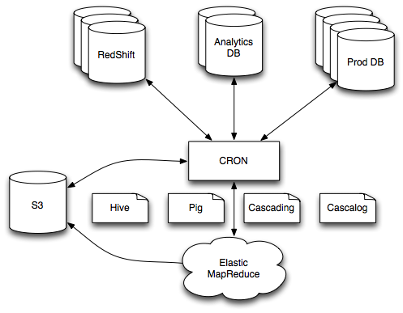
before chronos

Slide 366
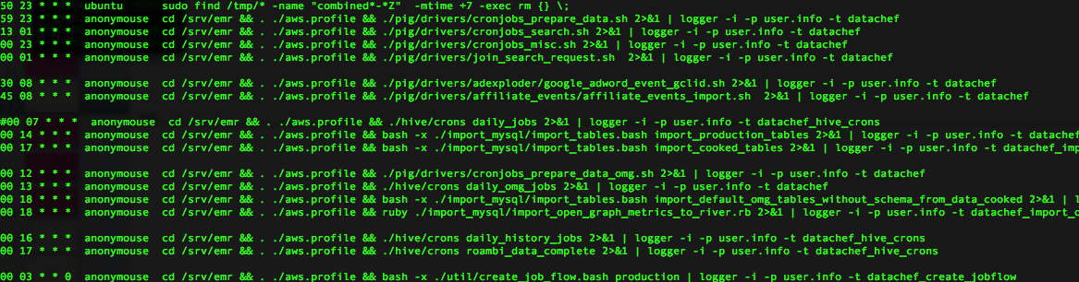
before chronos
single point of failure (and AWS was unreliable)
resource starved (not scalable)

Slide 367
chronos requirements
fault tolerance
distributed (elastically take advantage of resources)
retries (make sure a command eventually finishes)
dependencies

Slide 368
chronos
leverages the primitives of mesos
~3k lines of scala
highly available (uses Mesos state)
distributed / elastic
no actual network programming!

Slide 369
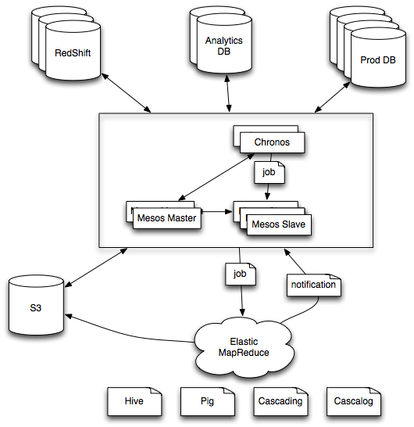
after chronos

Slide 370
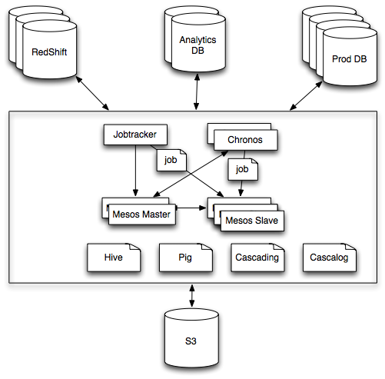
after chronos + hadoop

Slide 371
case study: aurora
“run 200 of these, somewhere, forever”
built at Twitter

Slide 372
before aurora
static partitioning of machines to services
hardware outages caused site outages
puppet + monit
ops couldn’t scale as fast as engineers

Slide 373
aurora
highly available (uses mesos replicated log)
uses a python DSL to describe services
leverages service discovery and proxying (see Twitter commons)

Slide 374
after aurora
power loss to 19 racks, no lost services!
more than 400 engineers running services
largest cluster has >2500 machines

Slide 375
Mesos
Hadoop
Spark
MPI
Storm
Chronos
Mesos
Node
Node
Node
Node
Node
Node
Node
Node
Node
Node
Node
Notes:
Before and after pics

Slide 376
Mesos
Hadoop
Spark
MPI
…
Mesos
Node
Node
Node
Node
Node
Node
Node
Node
Node
Node
Node
Notes:
Before and after pics

Slide 377
Mesos
Hadoop
Spark
MPI
Storm
…
Mesos
Node
Node
Node
Node
Node
Node
Node
Node
Node
Node
Node
Notes:
Before and after pics

Slide 378
Mesos
Hadoop
Spark
MPI
Storm
Chronos
…
Mesos
Node
Node
Node
Node
Node
Node
Node
Node
Node
Node
Node
Notes:
Before and after pics

Slide 379
tep 4: Profit (statistical multiplexing)
$

